Slide 1
Programming Constructs
Ibtisam Mogul
Notes:
https://www.youtube.com/watch?v=G41G_PEWFjE

Slide 2
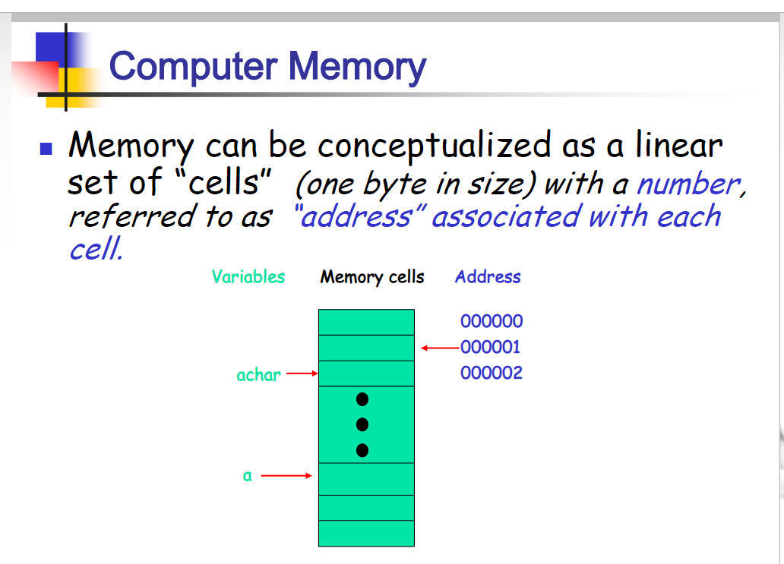
Notes:
https://slideplayer.com/slide/4949411/

Slide 3
Variables
Any software program requires data.
A data item is either:
a constant or a variable
Constant data - value cannot change.
“Variables” are simply storage locations in memory for data.
You can place data into them and
retrieve their contents later.
Variable data items can hold different values at different points of time.
Notes:
https://slideplayer.com/slide/4949411/
https://giphy.com/explore/super-mario-brothers
https://www.producthunt.com/posts/suave-2

Slide 4
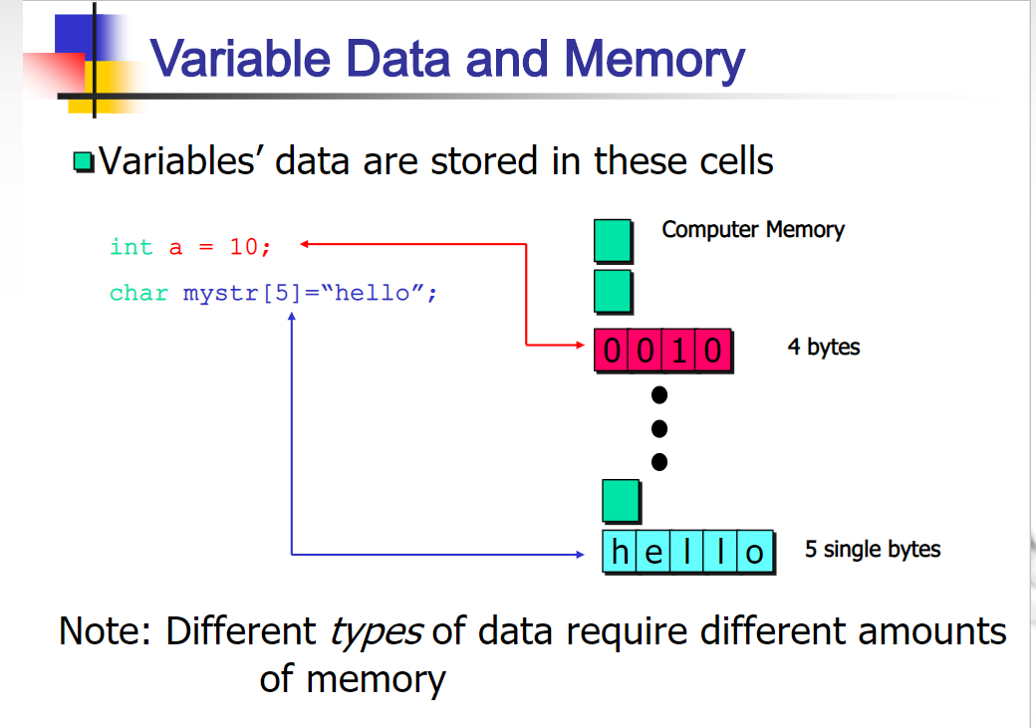

Slide 5
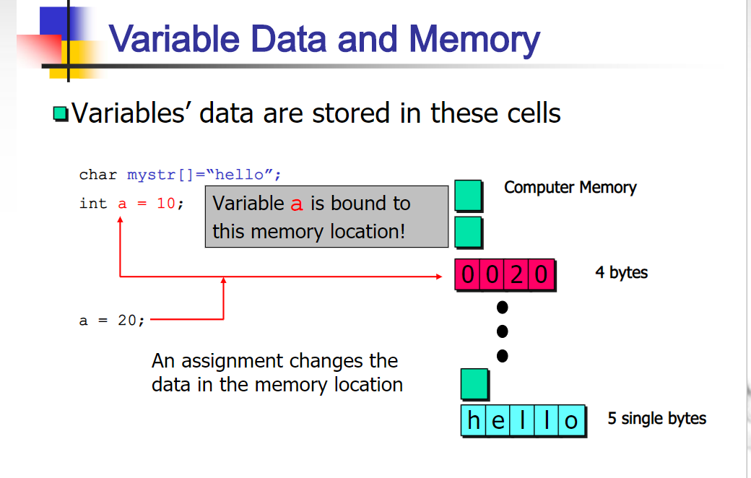

Slide 6
Data Type
All data items in a program have a data type
Data type describes
the format and size of a data

Slide 7
Different Data Types
Data types consist of:
Char
Numeric types:
Integer(int),
Floating Point(float),
Decimal(double)
String type
Boolean type

Slide 8
char Data Type
char data type is used to hold a single character (‘A’, ’b’, ’9’)
a character is enclosed in a single quotation mark ‘ ’
Examples:
char gender = ‘F’;
char grade=‘A’;
Task: Represent Operation Symbols + - / *

Slide 9
Numeric types
Integers, Floating Point, Double
Example:
int i=35;
float radius=3.67;
double exponential=3.712334555;

Slide 10
int Data Type
int
variables of type int store integers
int rollno=5;
int temperature= - 20;

Slide 11
Floating-Point Data Types
A floating-point number is one that contains
decimal positions
C# supports three floating-point data types:
float, double, and decimal
A double can hold 15 to 16 significant digits of accuracy
Examples:
float radius=3.67;
double exponential=3.712334555;

Slide 12
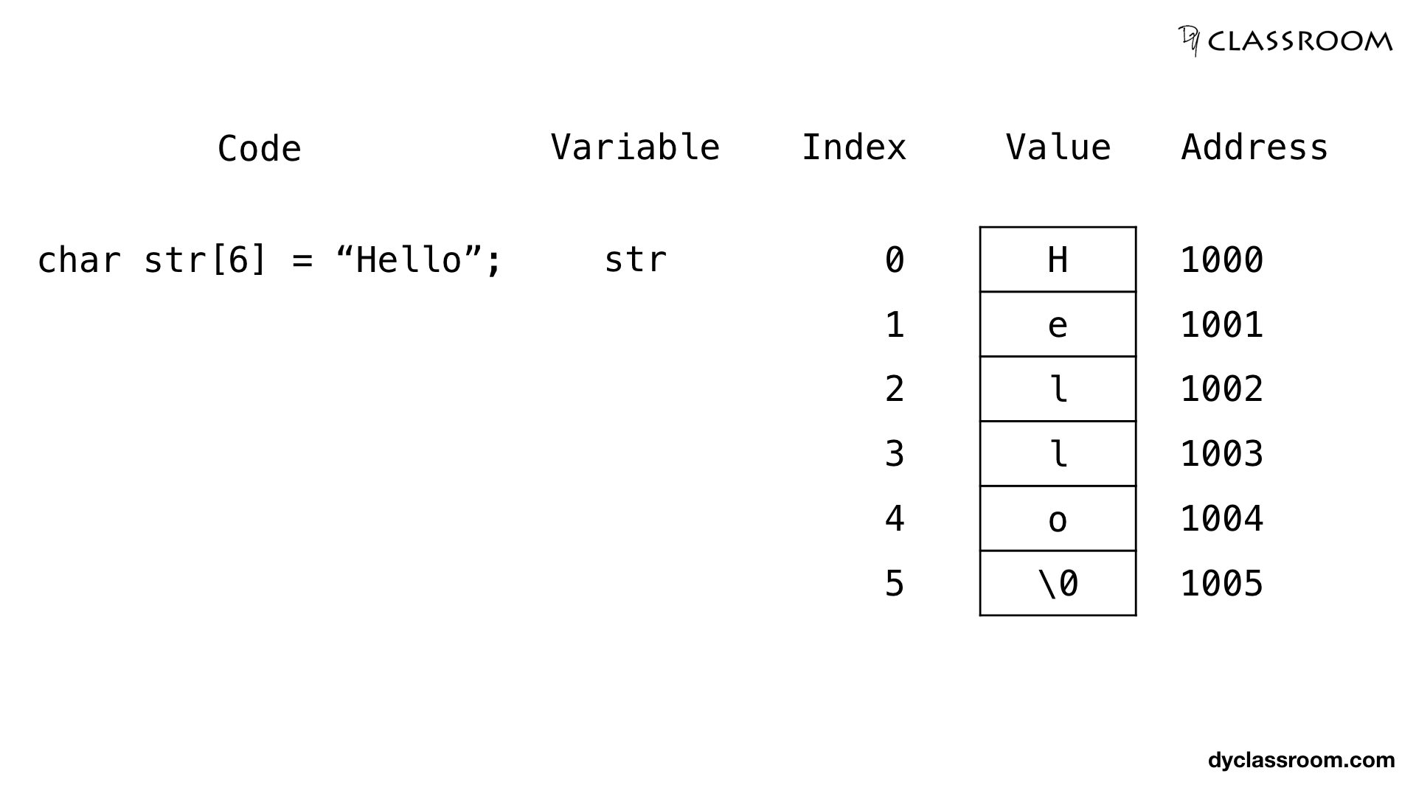
String type
string data type holds a series of characters enclosed by double quotes.
Example:
string name=”Clarke Kent”;
string country=“England”;
string university=“Bolton”;
String str=“Hello”;

Slide 13
Boolean type
Boolean types are declared using the keyword “bool”.
They have two values: “true” or “false”.
Example:
bool passed = true;
bool found = false;

Slide 14
Declaring Variables
A variable declaration includes:
data type(kind of data) that the variable will store
Example: int
Unique variable name. example: age
An optional assignment operator (=)and assigned value when you want a variable to contain an initial value. Example: int age =18
An ending semicolon(;)
Syntax:
datatype variable-name = value;
int age=18;

Slide 15
Declaring Variables & Initialization
Initialization
An initial Value is assigned when a variable is declared.
float area = 25.50;
It is not necessary to initialize a variable during a declaration.
For example
int myAge;
is a valid declaration
Later in program you may set its initial value,
myAge=18;

Slide 16
Declaring Variables
Examples of multiple variable declarations:
int myAge = 25;
int yourAge = 19;
Declarations of variables of the same type can be separated by commas.
int myAge = 25 , yourAge = 19;
Separate statements are used when declaring variables of different types
int myAge, yourAge ;
double mySalary, yourSalary ;

Slide 17
Displaying Variable Values
You can display variable values by using the variable name within a MessageBox.Show method call
float radius, area;
radius= 10;
area= 3.14 * radius * radius;
MessageBox.Show( Convert.ToString( area ) );

Slide 18
Displaying Variable Values
Program that displays a string and a variable value
float radius, area;
radius= 10;
area= 3.14*radius*radius;
MessageBox.Show(“The area is “ + Convert.ToString( area ) );

Slide 19
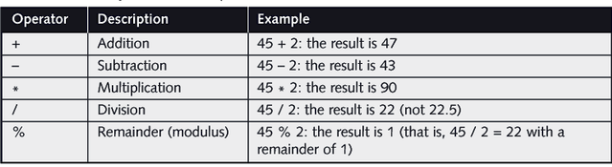
Binary Arithmetic Operators
5 most commonly used binary arithmetic operators (2 Operands)

Slide 20
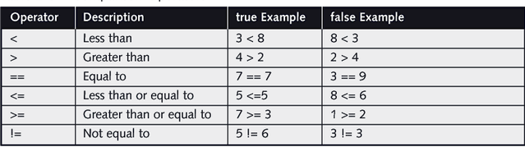
Boolean Data Type
Boolean logic is based on true or false comparisons
Boolean variables can hold only one of two values:
true or false
You can assign values based on the result of comparisons to Boolean variables

Slide 21
Constants
A constant is an identifier whose contents cannot change
You create a named constant using the keyword const
Programmers usually name constants using all UPPERCASE letters, inserting underscores for readability

Slide 22
Defining Named Constants
float radius, area;
const float PI=3.14;
radius= 10;
area= PI*radius*radius;
MessageBox.Show(“The area is “+Convert.ToString( area ) );

Slide 23
Accepting Textbox Input
A program that allows user input is an interactive program.
Consider a textbox named txtradius
To get its value use, txtradius.Text
This method accepts user input from the textbox.
But the user’s input is accepted as a string
You must use a Convert() method to convert the input string to the type required
int radius= Convert.ToInt32(txtradius.Text);

Slide 24
Lets Begin Programming on Visual Studio

Slide 25
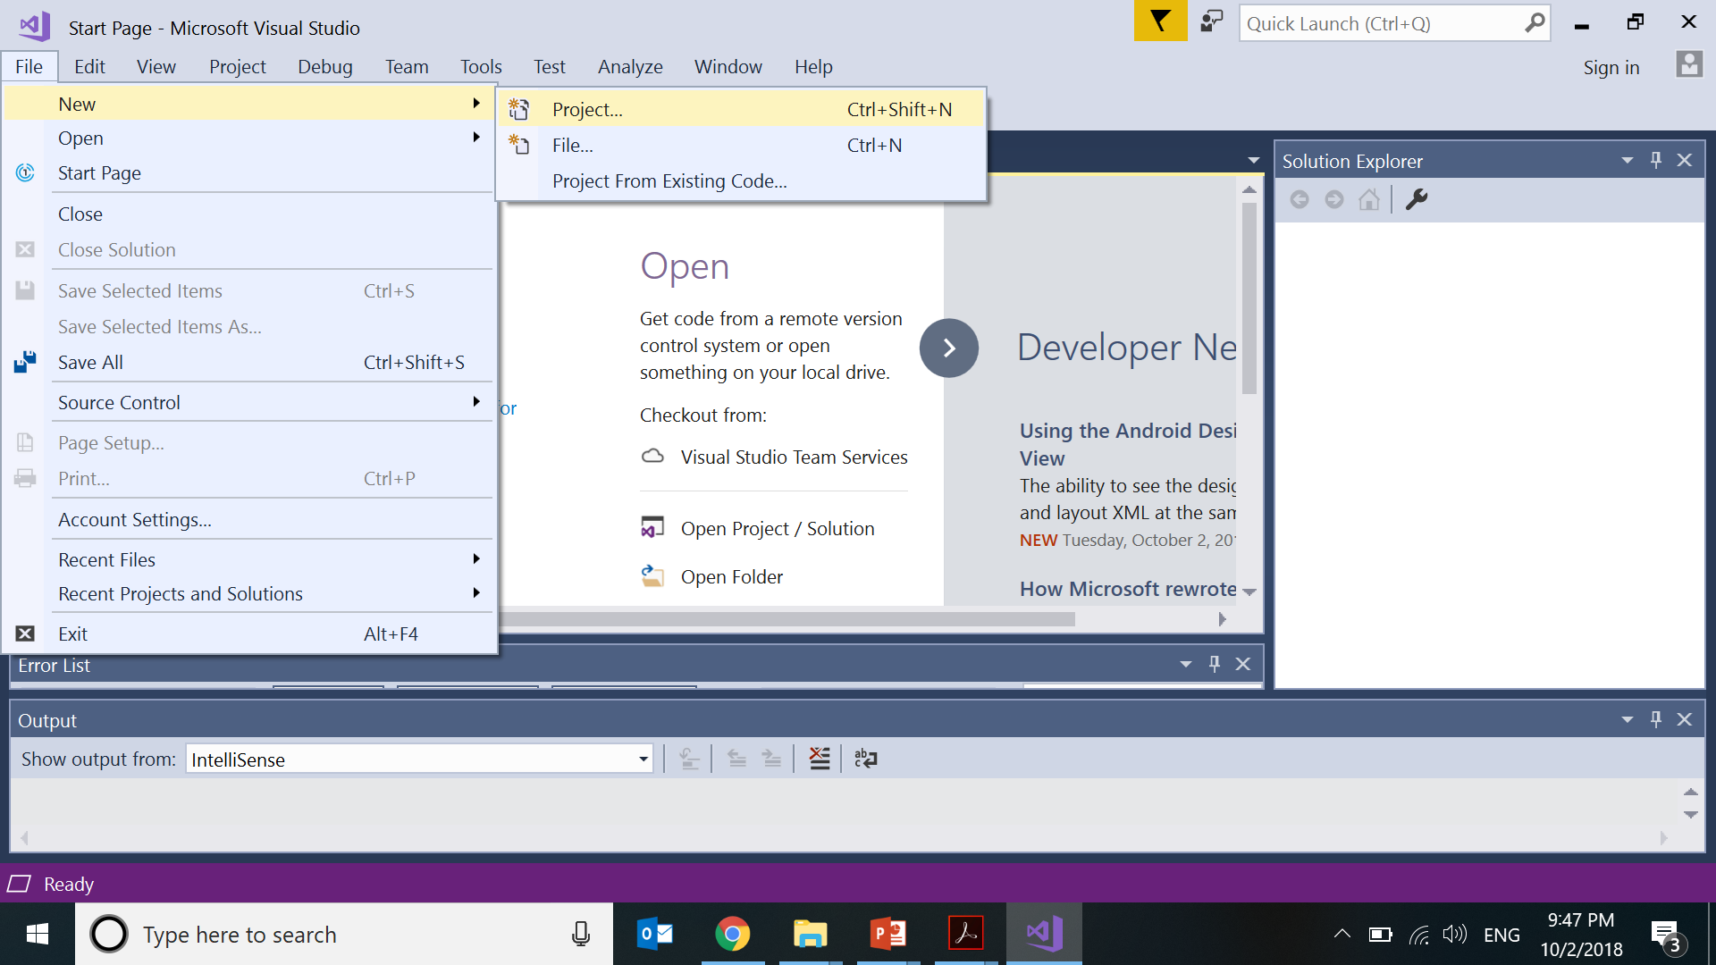

Slide 26
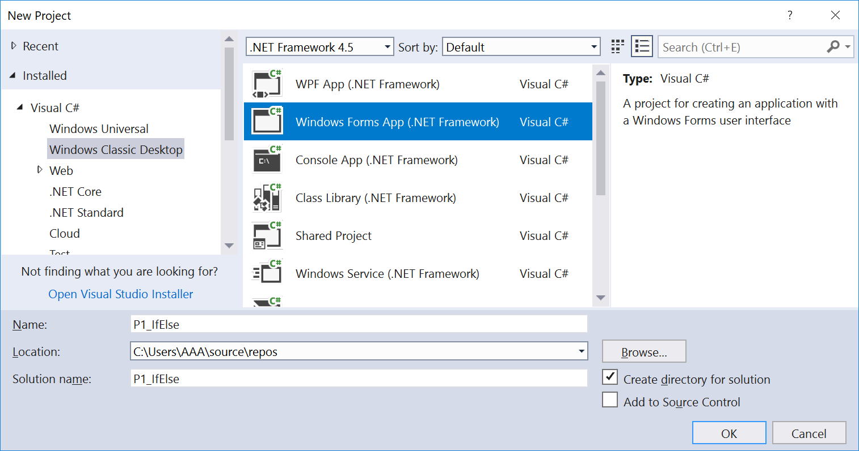

Slide 27
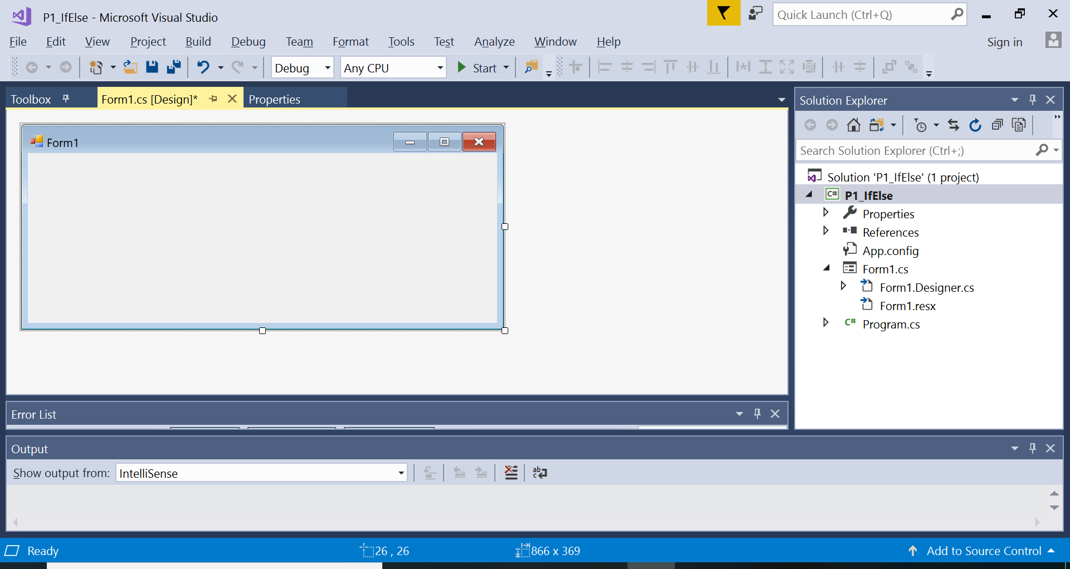

Slide 28
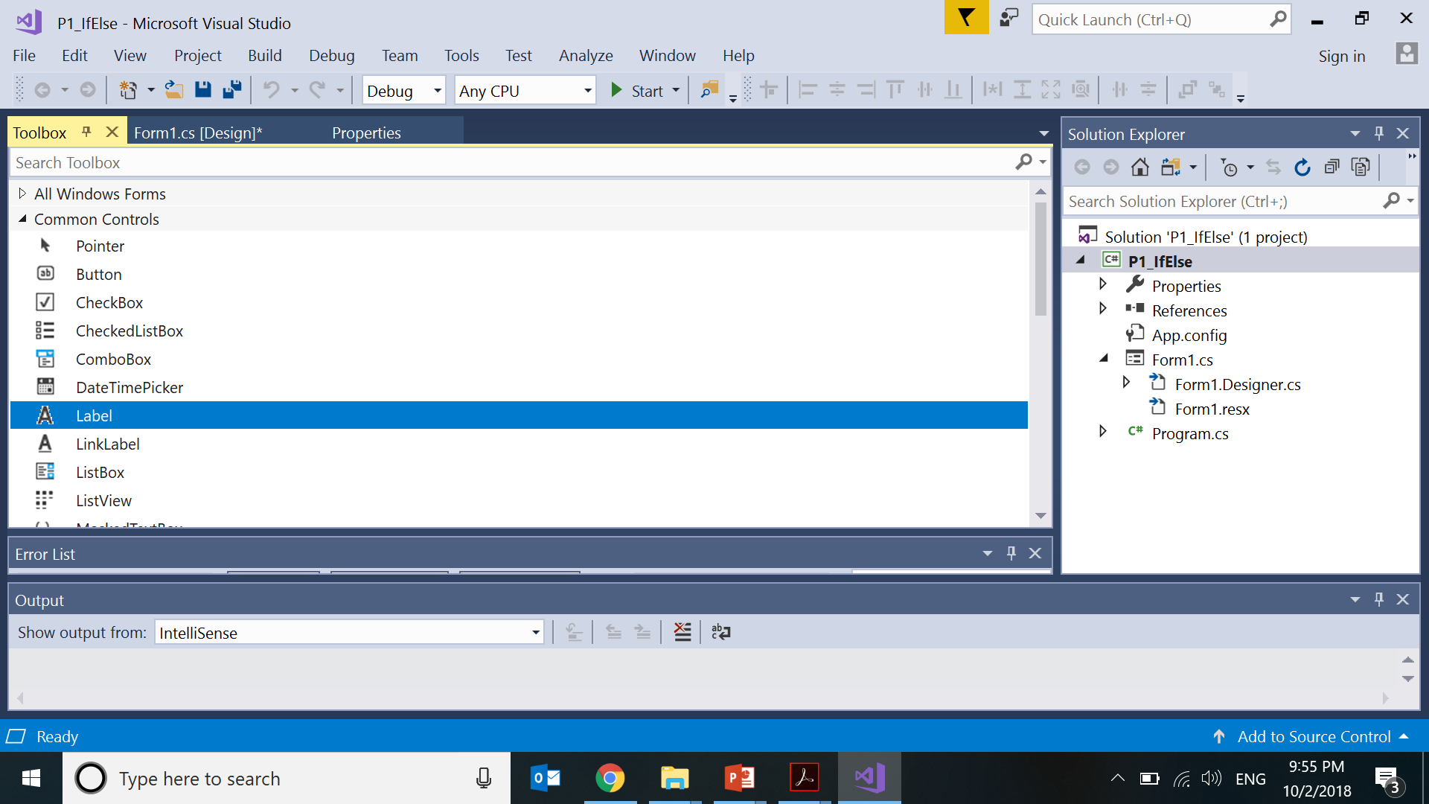

Slide 29
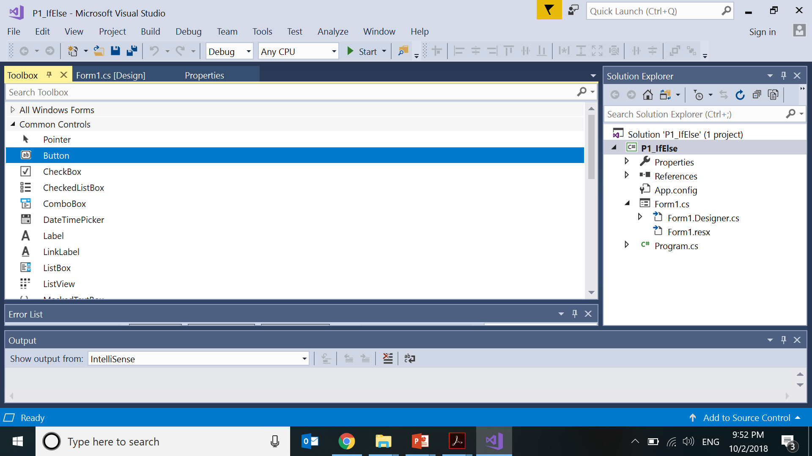

Slide 30
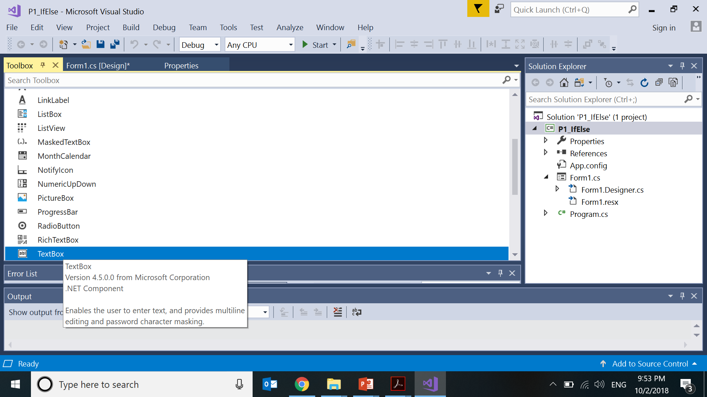

Slide 31
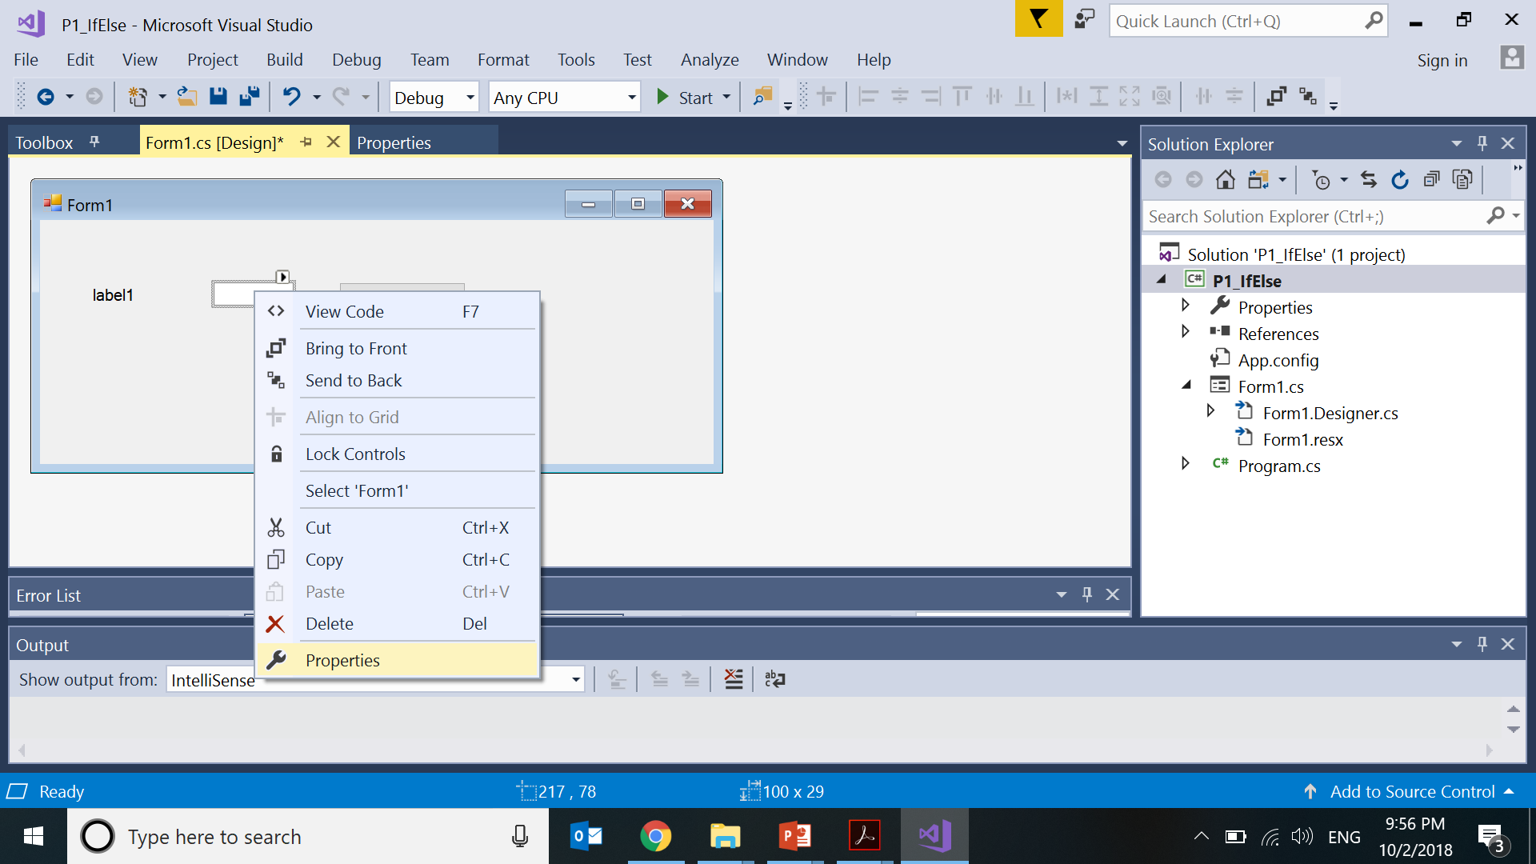
Right click textbox. Goto Properties

Slide 32
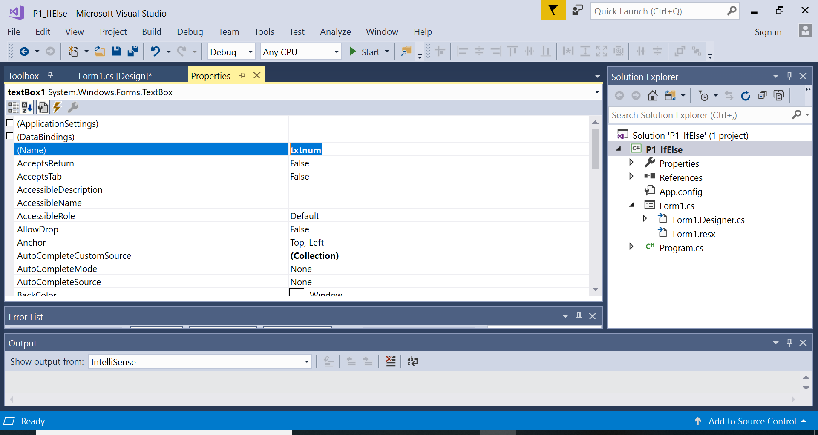
Change Name property to txtnum

Slide 33
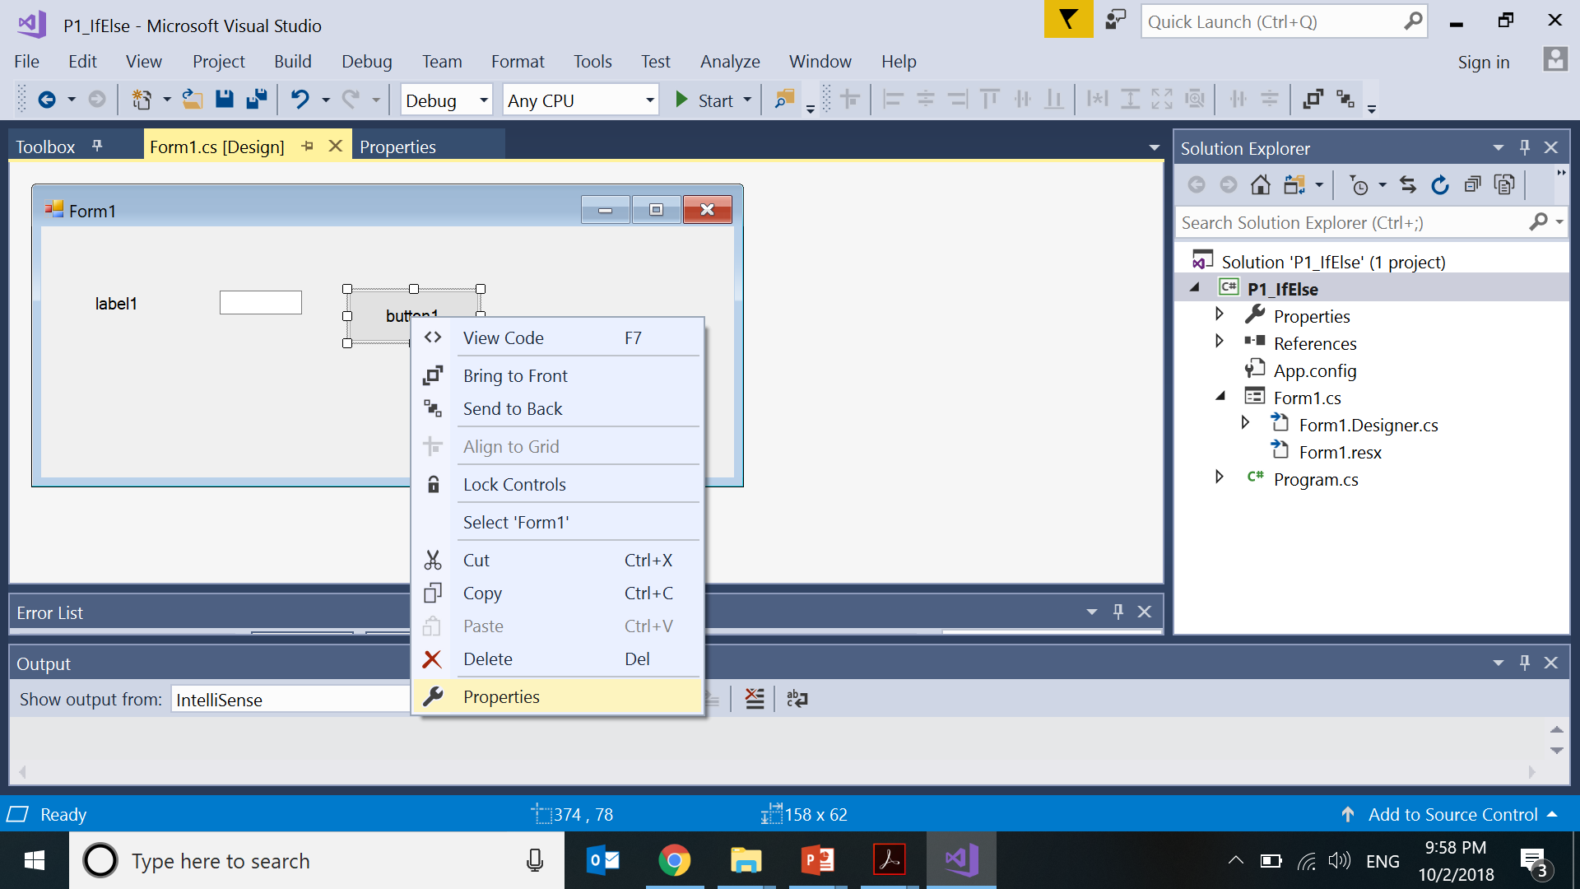

Slide 34
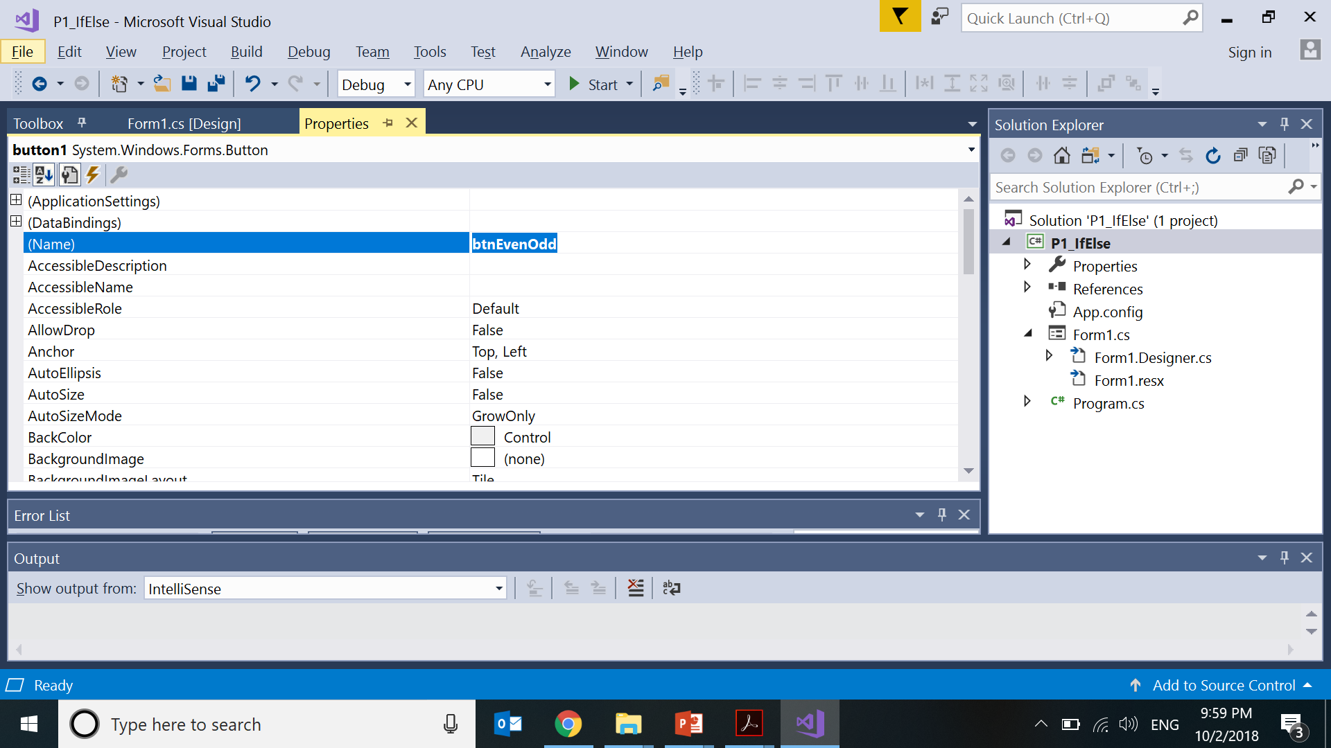

Slide 35
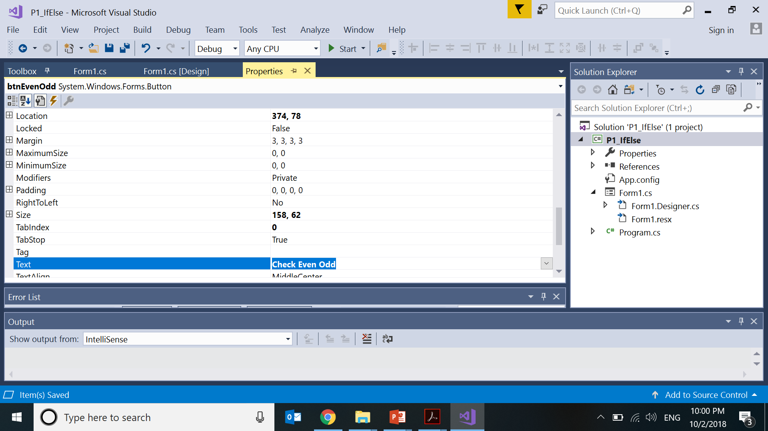

Slide 36
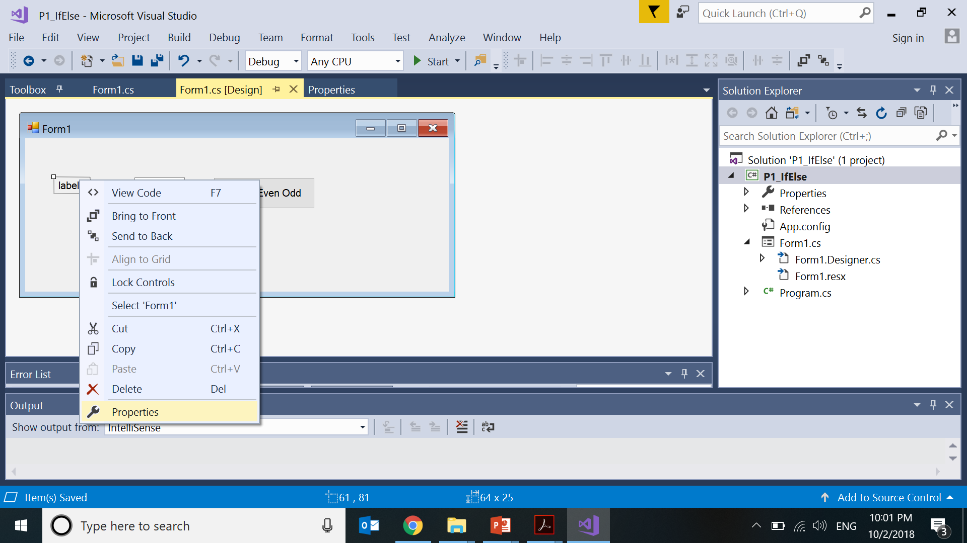

Slide 37
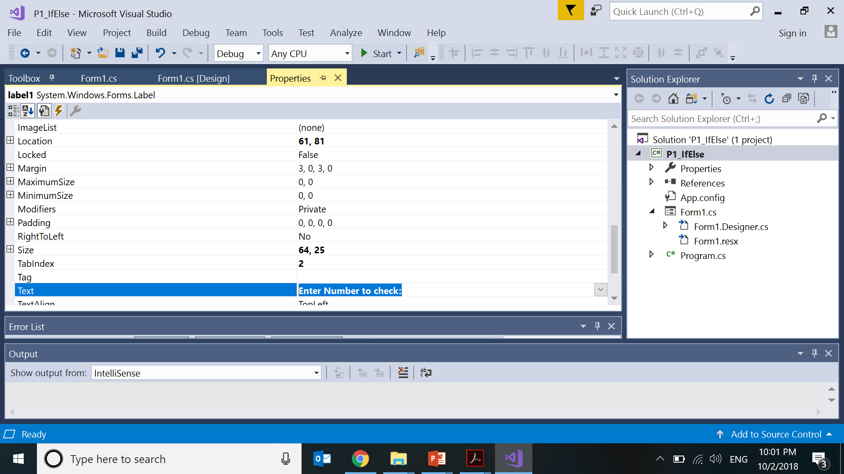

Slide 38
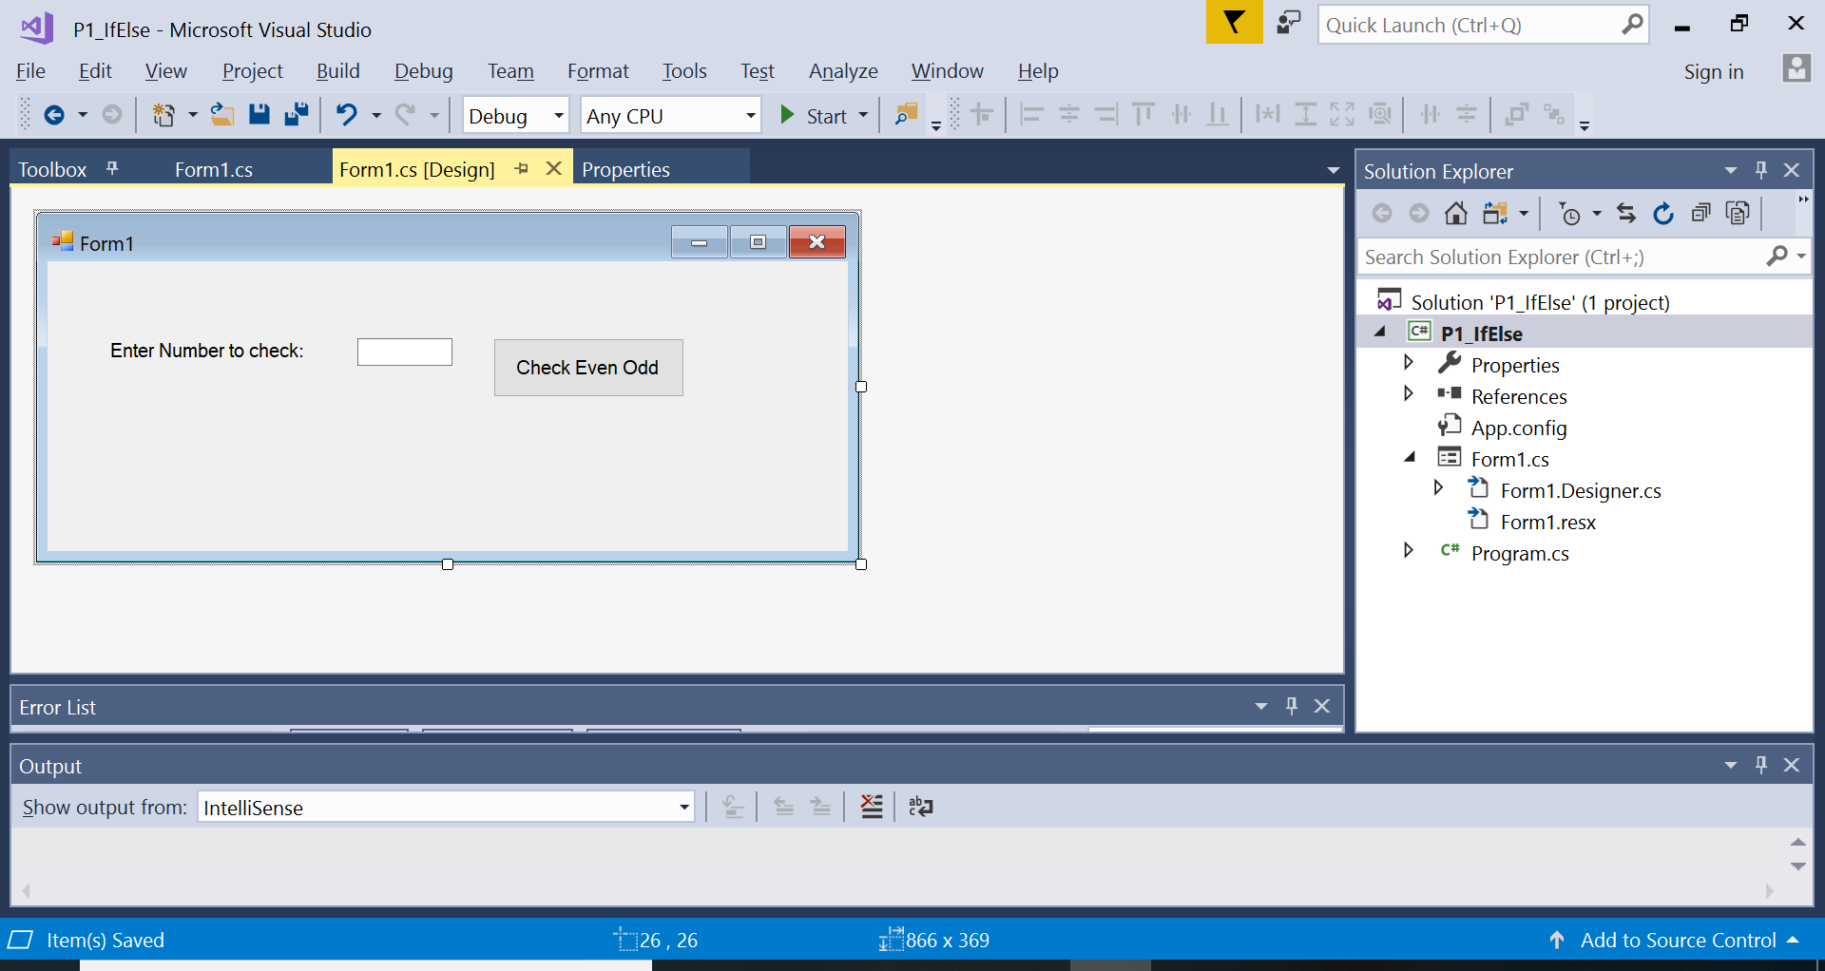

Slide 39
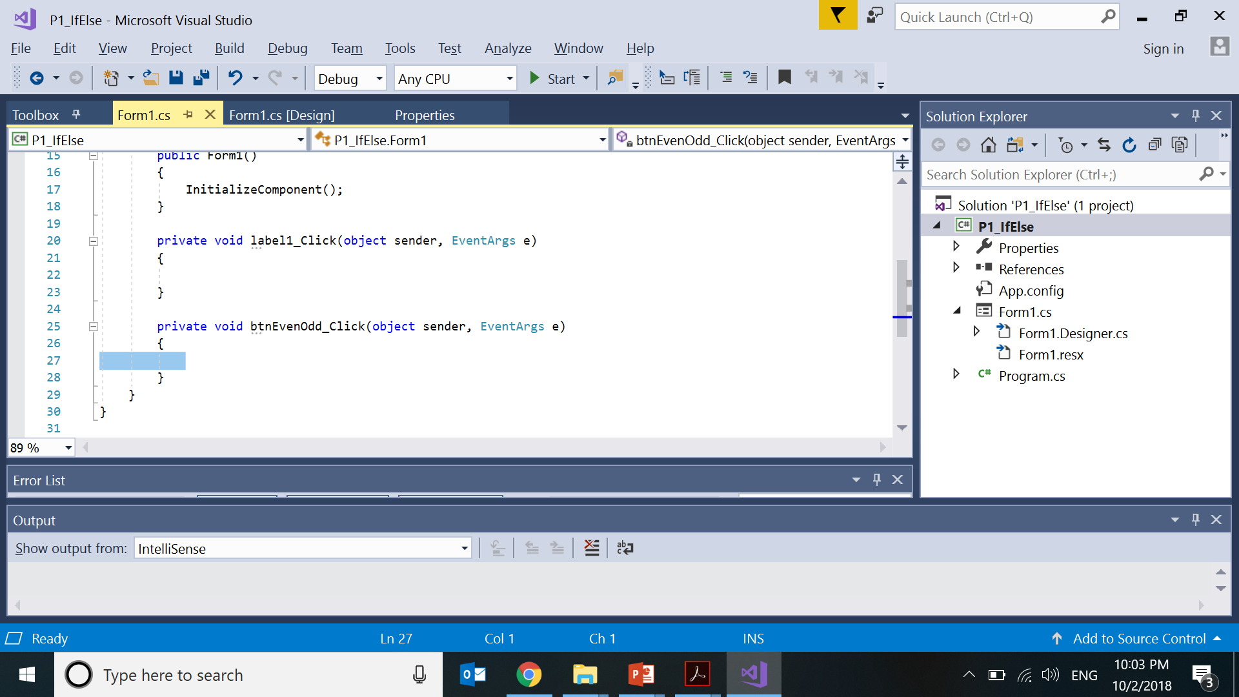

Slide 40
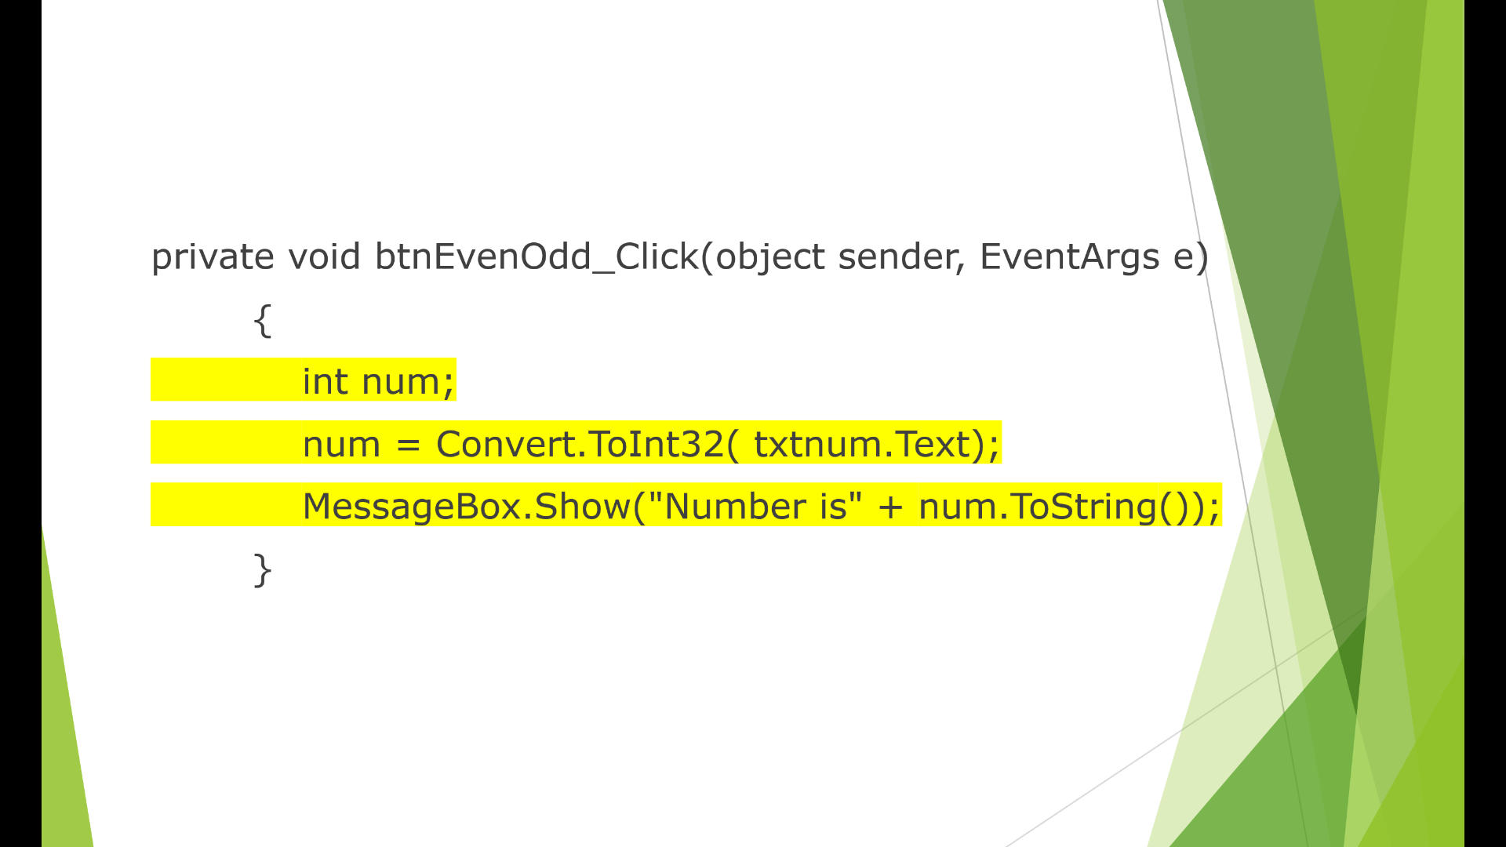

Slide 41
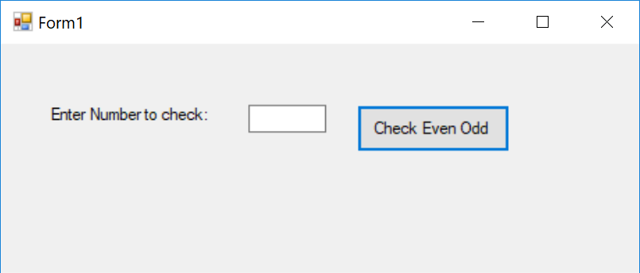
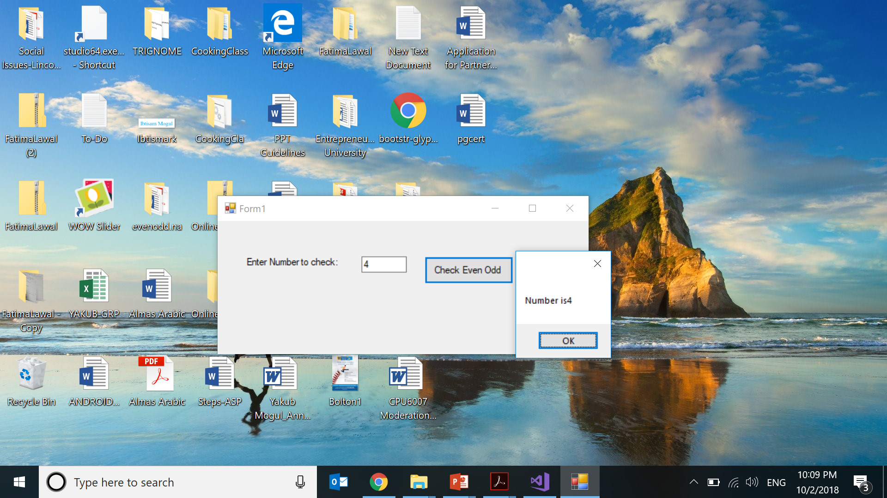
Click Start button on top

